Slide 1
How to Download and Install POSTMAN
Step 1) Download Postman Go to https://www.postman.com/downloads/ and choose your desired platform among Mac, Windows or Linux. Click Download.
Step 2) Click on Run Your download is in progress message should now display on the Apps page. Once the Postman download is completed, click on Run.
Step 3) Postman Installation Start Wait for some time to Complete the Installation of Postman.
Step 4) Signup for Postman Account In the next window, Signup for a Postman Account.
NOTE: There are two ways to sign up for a Postman account. One is to create an own Postman account, and the other is to use a Google account. Though Postman allows users to use the tool without logging in, signing up ensures that your collection is saved and can be accessed for later use.
Step 5) Click on Save My Preferences Select the workspace tools you need and click Save My Preferences.
Step 6) Congratulation! You will see the Startup Screen.

Slide 2
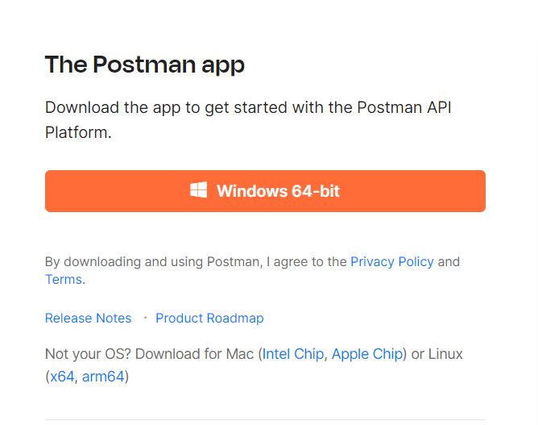
Step 1) Download Postman
Go to https://www.postman.com/downloads/ and choose your desired platform among Mac, Windows or Linux. Click Download.

Slide 3
Step 2) Click on Run Your download is in progress message should now display on the Apps page. Once the Postman download is completed, click on Run.

Slide 4
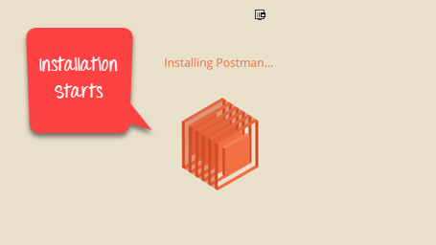
Step 3) Postman Installation Start Wait for some time to Complete the Installation of Postman.

Slide 5
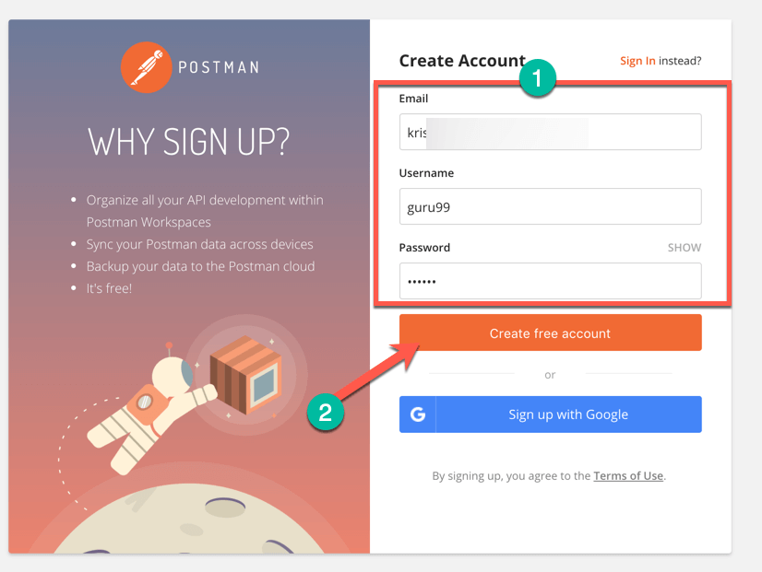
Step 4) Signup for Postman Account In the next window, Signup for a Postman Account

Slide 6
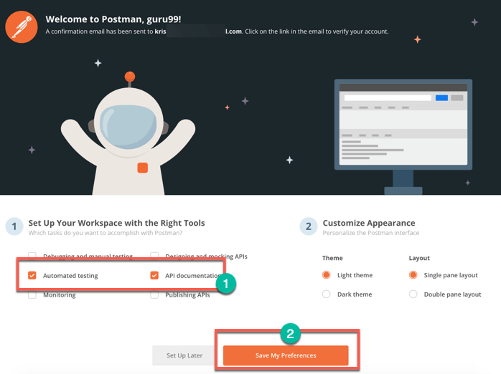
Step 5) Click on Save My Preferences Select the workspace tools you need and click Save My Preferences

Slide 7
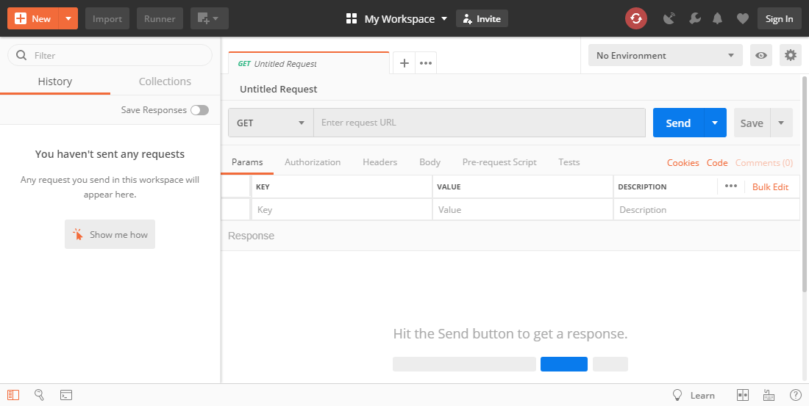
Step 6) Congratulation! You will see the Startup Screen

